Slide 1
“Relevant personal quote that captures the persona’s attitude and personality”
Add image that represents this persona
Goals
The related objectives this person wants to successfully complete
Frustrations
The issues or pain points that they encounter or try to avoid
Name
Age:
Education:
Hometown:
Family:
Occupation:
Brief story or scenario that conveys the persona’s user journey, highlighting their goals, frustrations, and other relevant context.

Slide 2
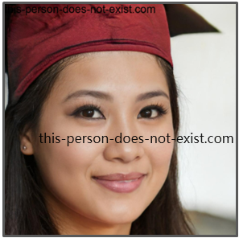
"Through determination and a vision for a brighter future, I'm navigating life's challenges, one step at a time, for the sake of my child and my dreams."
Goals
Establish her Amazon e-commerce business as a newcomer.
Achieve financial independence to support herself and her child.
Build a brand that aligns with her values and provides a stable future.
Frustrations
Limited experience in e-commerce and Amazon selling.
Challenges due to her low vision in managing the business effectively.
Lack of a Chinese version of the app to access resources in her preferred language.
Yu Li
Age:
Education:
Hometown:
Family:
Occupation:
34
Bachelor's degree
Yiwu, China
Daughter
Aspiring entrepreneur and Amazon seller
Emily's user journey begins with her desire to secure a better future for herself and her child through e-commerce. As a newcomer, she faces challenges navigating Amazon's complexities and managing her business, compounded by her low vision. Emily actively seeks accessible tools, including a Chinese version of the app, to overcome these hurdles and pursue her entrepreneurial dreams.

Slide 3
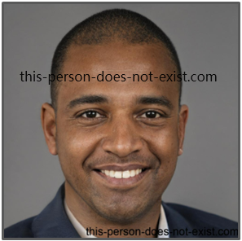
“Promoting diversity is not just a passion; it's my purpose. Through e-commerce, I'm painting the world with inclusivity, one product at a time.”
Goals
Expand his successful e-commerce business as an experienced seller.
Promote diverse and inclusive products that celebrate underrepresented voices.
Advocate for LGBTQ+ and diversity causes through his business.
Frustrations
Challenges in scaling the business and effectively managing inventory.
Difficulty finding suppliers and manufacturers that align with his values of diversity and inclusion.
Crafting marketing strategies tailored to his specific target audience poses a unique challenge.
John Brown
Age:
Education:
Hometown:
Family:
Occupation:
28
High school graduates
New York
parents, siblings
Experienced Amazon seller, entrepreneur
Danny's user journey begins with his transition from a corporate career to successful Amazon entrepreneurship. Despite his experience, he grapples with scaling the business and ensuring his commitment to inclusivity and diversity is maintained. Danny actively seeks innovative solutions to effectively manage inventory, connect with suppliers who share his values, and develop marketing strategies that resonate with his diverse target audience.

Slide 4
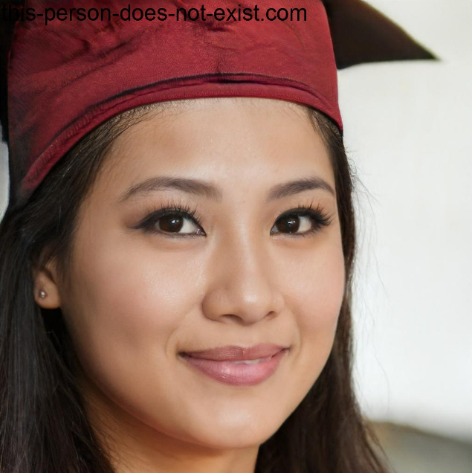
“I like trying different coffee instead of making it myself to better experience the coffee culture.”
Goals
To experience all the good coffees this city of cafes can offer.
To enjoy the creative and inspiring vibe that an outstanding cafe provides.
Frustrations
The cafe's website and menu only has the French version, so there is a language barrier for non-French speakers.
To use translation tools is not very convenient.
Lei Zicing
Age:
Education:
Hometown:
Family:
Occupation:
26
Master
Hong Kong
Single
Entrepreneur
(Founder & CEO of her design company)
Zicing is now living and working in Paris and knows a little French. She is attracted by Paris fashion and design culture, but she cannot communicate in French very well. Most of her business partners speak English and so does Zicing, so she can communicate with them well. However, when it comes to life, language is a barrier to her. She hopes there are more shops like cafes can provide the English version of their products and services.
Notes:
need English or Chinese version

Slide 5
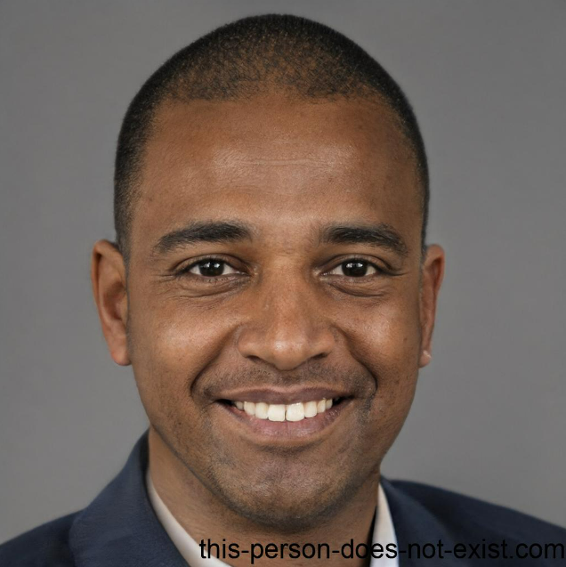
“I live a busy lifestyle and I need a café which has a cozy and inviting vibe which can help me relax.”
Goals
To be a great developer for their clients.
To maintain a good work-life balance while enjoying the café vibe
Frustrations
“The cafes are not well designed and bring me little relaxation.”
“The cafes’ website design doesn’t not consider people with low vision like me.”
“The cafes are too far away from my home”
John Brown
Age:
Education:
Hometown:
Family:
Occupation:
35
Bachelor
Adelaide
Single father of a son
Developer
John is a developer with a busy and demanding schedule. They work as an Android developer in a mid-sized IT company, and volunteer for a local charitable organization. John has low vision for which they use tools and technologies that can help make reading and work like programming accessible. But not all products provide these tools. John would like the web app providing technologies like text-to-speech.
Notes:
disabled with low vision，gay

